Slide 1
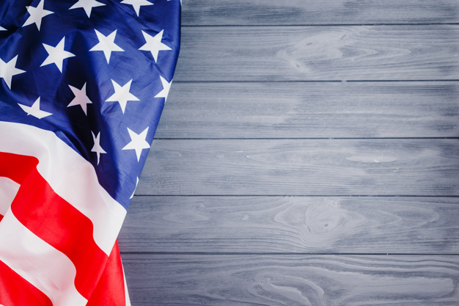

IST 718 - BIG DATA ANALYTICS
SOCIAL
DESIRABILITY BIAS
AND
OTER LIE DETECTION
Lauren Lawless
Kiel Brunner
Nyesher Serrant
Joe Hernandez

Slide 2
SOCIAL
DESIRABILITY BIAS
POLLING POST-2016
BACKGROUND INFORMATION
“Social desirability bias is the tendency of some respondents to report an answer in a way they deem to be more socially acceptable than would be their ‘true’ answer” (Lavrakas, 2008).
Intent: project a more favorable image
Outcome: overreporting of socially desirable behaviors and underreporting of socially undesirable behaviors
The situation:
Voter polling remains integral to election analysis, despite the expanded use of other modeling and statistical techniques.
The catalyst:
The 2016 election of Donald Trump and increased political divisiveness since have led to social desirability bias in self-reported data.
The result:
Skewed voter preference predictions
Over-investment in unpersuadable voters
Notes:
Kiel
Social desirability bias has been linked to voting patterns. The Bradley Effect was coined when polling for an african american candidate well out performed his standing at the polls.
Polling is still the best way to get a snapshot of the election.
Trump out performed his polling and election day exit polls.
Campaigns need to be able to target actual persuadables and ignore those groups most likely to differ in polling and ballot decicions.

Slide 3



QUESTIONS
What demographic characteristics and political issue preferences influence a voter’s decision to support Trump?
Who, then, should a Democratic candidate expend resources to persuade, and who is likely to support Trump despite not admitting to it previously?
Can a model based on these characteristics detect social desirability bias and help us determine the likelihood that a person would lie about having previously supported Trump?
Notes:
Kiel
We will look at age, gender, party and ethnicity as the core demographic groupings.
As of today, Tulsi Gabbard will not be needing this model, but hopefully it can find targets that the polling is likely to have missed
In 2016, it was suburban white women who misled pollsters and headed to the polls for Trump

Slide 4

SOLUTION STRATEGY
Using data from AP VoteCast 2018:
Examine individuals’ responses to Trump-support-equivalent questions:
2016 candidate choice
2020 anticipated candidate choice
Trump approval
Voting in 2018 to show support for Trump
Trump favorability
Determine likelihood that the person supported Trump in 2016
Compare to reported 2016 candidate choice to determine likelihood that social desirability bias influenced the response
This probability will help inform the campaign of the 2020 Democratic nominee about which voters are “gettable” and which would otherwise be an inefficient use of resources.
Notes:
Kiel
We created a variable that compiled several questions asking people their support of Trump.
The data was from 2018 and asked who they voted for in 2016, if Trump was doing a good job and who they would be supporting in 2020.
Based on those answers, we hope to create a score for each respondent based on other factors and predict future behavior.
HAND OFF TO LAUREN

Slide 5

DATA ACQUISITION PROCESS
AP VoteCast was designed to improve polling accuracy by broadening traditional polling methods and providing unprecedented public access to the debut data set.
Observations: 106,855 (7 train : 3 test)
Variables: 53, including dummies
Notes:
Lauren
a. Our data came from AP VoteCast 2018, which is pretty revolutionary for exit polling techniques since they use a combination of online and traditional phone polling to ask a robust set of questions and provide unprecedented public access to the anonymized results.
b. Since there were five different questionnaire forms, not everyone was asked all questions, but by the time we applied our Trump-support formula and conducted some feature elimination and null-dropping, we ended up with complete records for 106,855 individuals, which we split into 70/30 train and test sets.
c. The variables we chose include typical demographic questions as well as some issue-specific questions, giving 53 variables in all, after encoding of the dummy variables.

Slide 6
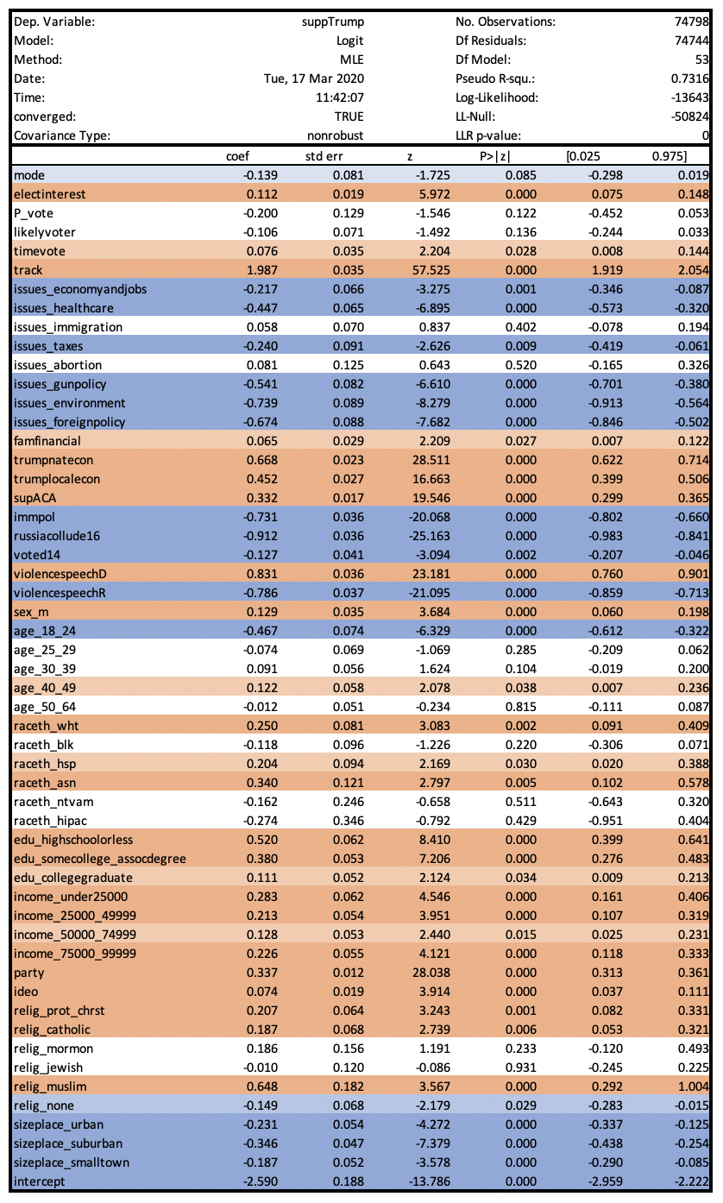
ESTIMATING SUPPORT
FOR TRUMP
Significant negative impacts:
Issues (economy, healthcare, taxes, gun policy, environment, foreign policy)
Immigration policy (path to citizenship)
2016 Russian collusion
Age (18-24)
Non-religious
Urban, suburban, and small town
Significant positive impacts:
Country track
Trump economic impact
Repeal ACA
Sex (m)
Age (40-49)
Race/ethnicity (White, Asian, Hispanic)
Education (“less is more”)
Income (lowest for $50k-$75k)
Party/ideology (scale: 0 Democrat/very liberal … 4 Republican/very conservative)
Religion (Protestant, Catholic)
Notes:
Lauren
a. The first model we ran was aimed at estimating an individual’s probability of supporting Donald Trump. Again, I want to emphasize that this is a separate variable from the 2016 vote choice because, while it does take that question into account, it also considers responses to other Trump-peripheral questions, like favorability, approval, etc.
b. To the right, you can see the logistic regression summary, with positive significant coefficients in orange, negative significant coefficients in blue, and color darkness representing different levels of significance at 1%, 5%, and 10%.
c. The most important indicators of a non-supporter are these negative impact variables:
i. Selection of the most important issue facing the country being the economy, healthcare, taxes, gun policy, the environment, or foreign policy,
ii. Preferring a path to citizenship for undocumented immigrants over deportation,
iii. Believing that the Trump campaign colluded with Russia in 2016
iv. Being a member of the youngest voting group, between 18 and 24 years old,
v. Being non-religious,
vi. And living in a non-rural area.
d. A lot of these are expected results, informed by general wisdom regarding party and vote preference.
e. By contrast, the most important indicators of a supporter are the positive impact variables:
i. Believing the country is on the right track,
ii. Believing the Trump administration is helping national and local economies,
iii. Support for repealing the Affordable Care Act,
iv. Being male,
v. Being middle-aged,
vi. Membership in specific racial or ethnic groups, particularly White, Asian, and Hispanic, which is somewhat surprising,
vii. Education, where we see decreasing support with increasing levels of education,
viii. Income, which, if it were formatted as a continuous instead of dummy variable, might have a quadratic effect, since we see higher levels of support on either end with decreased support among middle-income groups,
ix. Party and ideology, where Republican and Very Conservative are both 4s on 0-4 point scales,
x. And religion, particularly Protestant and Catholic.

Slide 7
MODEL COMPARISON
Model | Train Time (seconds) | Predict Time (train, test; seconds) | Accuracy (train, test) | Confusion Matrix (test)
Logistic | 2.57 | 0.02 0.01 | 0.9301719 0.9317465 |  |  | Prediction
 |  |  |  |  |  | 0 | 1
 |  |  |  | Support Trump | 0 | 17,547 | 1,016
 |  |  |  |  | 1 | 1,172 | 12,322
Random Forest | 7.51 | 1.76 0.64 | 0.9740100 0.9332751 |  |  | Prediction
 |  |  |  |  |  | 0 | 1
 |  |  |  | Support Trump | 0 | 17,553 | 1,010
 |  |  |  |  | 1 | 1,129 | 12,365
Notes:
Lauren
a. We ultimately ran two models for this categorization task: the logistic regression and a random forest, since we are using primarily categorical variables.
b. In terms of performance, the logistic model had slightly faster training and predicting times, but neither model was prohibitively slow, and both models’ test accuracies maxed out at slightly above 93%.
c. The primary difference in the two is that random forest is a black box model, so if you care about considering the individual model components, then you may prefer the logistic model. Otherwise, the slight accuracy gain from the random forest may be useful when considering resource allocation on the scale of a quarter billion voting-aged individuals.

Slide 8
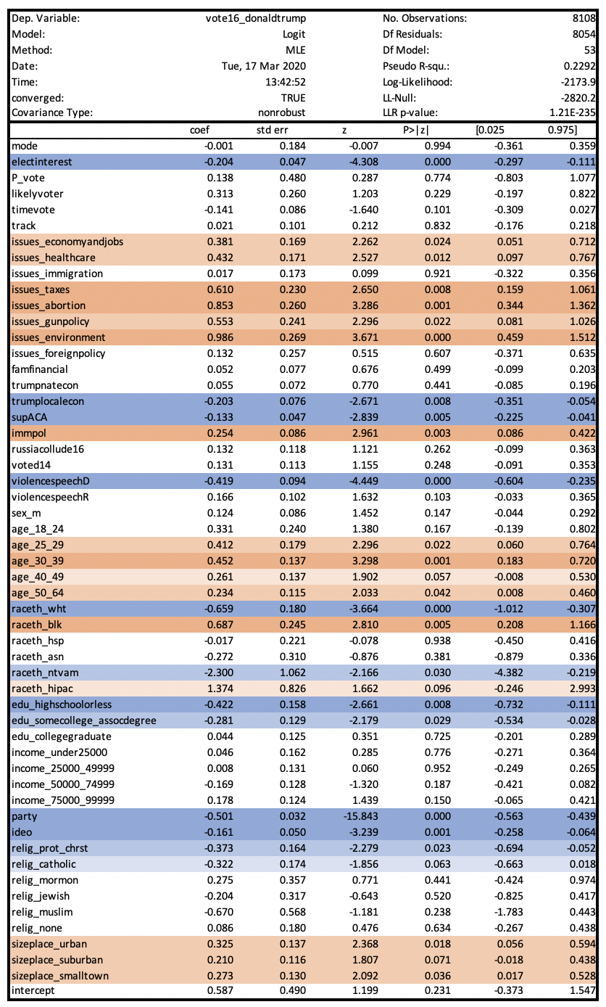
QUANTIFYING INFLUENCE OF
SOCIAL DESIRABILITY BIAS
Significant positive variables indicate likely social desirability bias among Trump supporters*:
Issues (abortion, environment, gun policy, healthcare)
Age (25-39)
Race/ethnicity (Black)
Non-rural
Notes:
a. Among those who indicate support for Trump, we ran an additional model attempting to quantify the differences between those who reported voting for Trump and those who did not.
b. I would like to note that not every survey respondent was asked about 2016 vote choice, so this model only considers those who were asked, and is therefore a much smaller set of observations. That said, it remains informative in terms of who does not report having voted for Trump but otherwise indicates some level of support.
c. So, among these individuals who give some indication of support for Trump, those most likely to say they did not vote for him are Millennials, are Black, live in non-rural areas, or consider issues like abortion, the environment, gun policy, and healthcare to be the most important issues facing the country. These are all groups where support for Trump is generally unpopular, which confirms our theory of social desirability bias in the data.
d. While the value of a secret ballot is democratically irreplaceable, this means that unfortunately we have no way to know whether these individual voters actually did vote for Trump despite their membership in these demographic or ideological groups or whether they did not vote for him despite otherwise expressing some level of support.
e. The implication here is that individuals having these attributes who are predicted by our primary model to be Trump supporters may have confounded results and that they are potentially gettable voters if we project the right message to them.

Slide 9
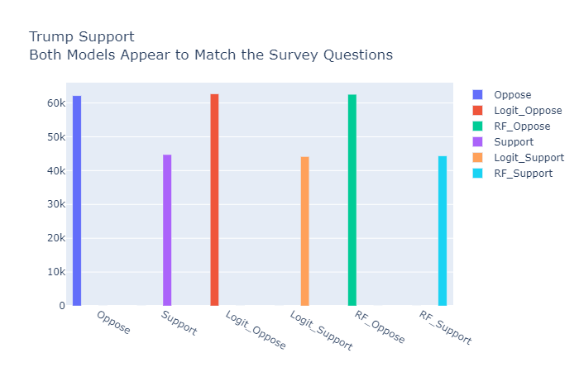
GRAPHS
Notes:
Kiel
Overall, each model maps very well to the survey questions. Support to oppose rations are very close.

Slide 10
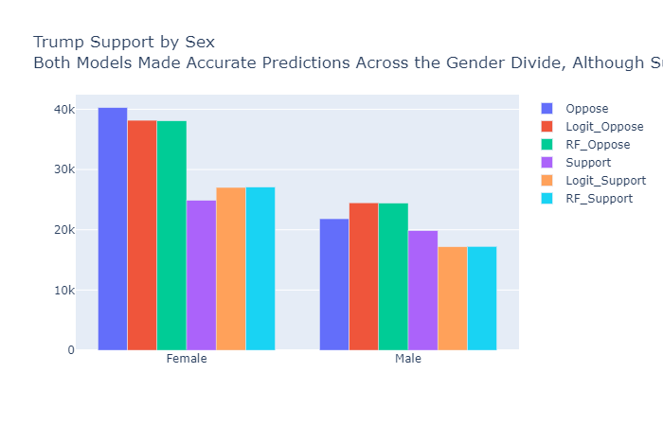
GRAPHS
Notes:
Kiel
The gender divide is real. Proportionally more women oppose Trump than men.
But we see and know that female opposition is overstated in the survey compared to the polls and models.
The opposite can be seen for men.
I will go to the next slide rather than speculate on why men backed off from their outward support and women hide their actual vote.

Slide 11
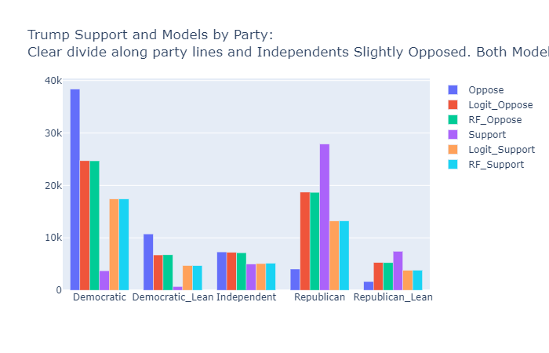
GRAPHS
Notes:
Kiel
Partisanship is the clearest indicator of support for the survey
If we were to spend more time with the model, we would want to create a weight for party that would make it more deterministic.

Slide 12
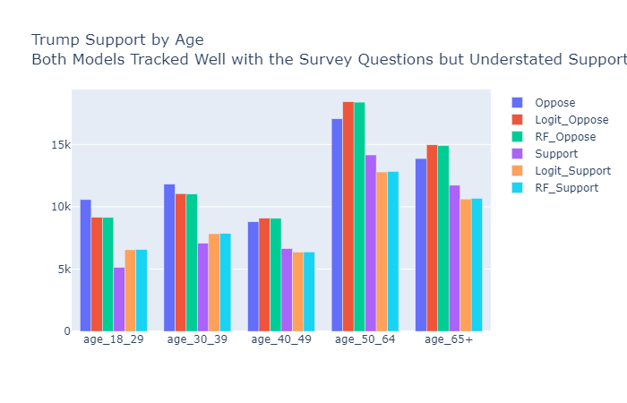
GRAPHS
Notes:
Kiel
Support and opposition for each group trended for both models.
The model predicted lower support than what was stated for older voters and the opposite for younger voters.
We know that younger non-college voters supported Trump at higher rates than the polling and the model appears to pick that up.
Old people ruin everything and while they may not say that they love Trump, the model ballot and model would suggest otherwise

Slide 13
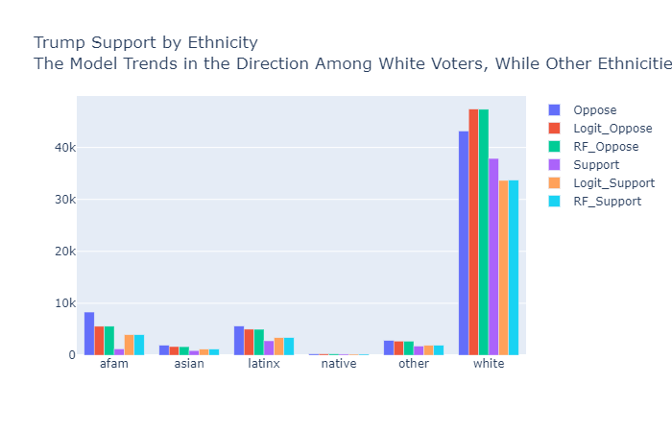
GRAPHS
Notes:
Kiel
We can see the trend among white people is similar to old people.
The model predicts their support to exceed their willingness to admit to it.

Slide 14
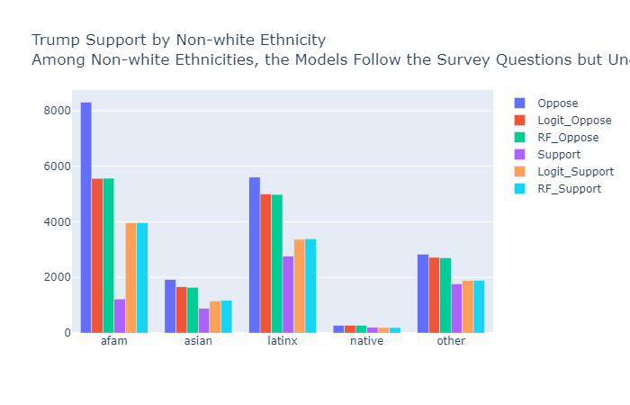
GRAPHS
Notes:
Kiel
Ethnicity is another area that we should look at weighting as we know that voters of color stand by their strong opposition to Trump in polls and at the polls.

Slide 15
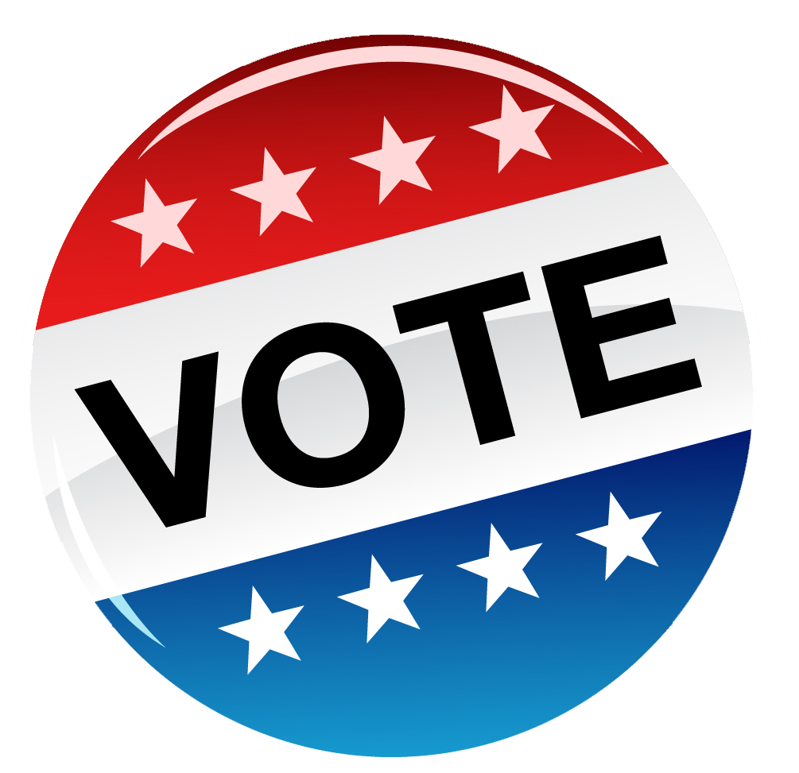
INTERACTIVE DASHBOARD
LIVE DEMO
Notes:
Kiel - PASS TO LAUREN

Slide 16
USER INTERFACE
LIVE DEMO
Notes:
Lauren

Slide 17

CONCLUSION AND RECOMMENDATION
Voters in specific demographic or ideological groups are sometimes less willing to admit to supporting Donald Trump.
The campaign team of the 2020 Democratic nominee should estimate an individual’s likelihood of supporting Trump based on information other than 2016 vote choice, since this is often underreported.
The best indicators include sex, age, education, religion, and specific issue opinions and beliefs (e.g., repeal/expand ACA, Russian collusion, deportation/naturalization of undocumented immigrants, direction of country).
Notes:
Lauren
a. First, we have successfully demonstrated that some voters in certain demographic or ideological groups where support for Trump is unpopular are either more likely to misrepresent how they voted or to have not voted for him despite showing some degree of support, so direct reporting of prior vote choice is not always a reliable indicator of future behavior.
b. And second, as a result of the first conclusion, democratic campaigns should consider more factors than just 2016 vote choice in estimating a voter’s likelihood of supporting Trump in 2020.
C. These factors should include sex, age, education, religion, and opinions on issues previously mentioned, such as repeal or expansion of the Affordable Care Act, belief in Russian collusion, deportation or naturalization of undocumented immigrants, and the direction of the country.

Slide 18
LIMITATIONS
The data used for this project was collected leading up to the 2018 midterm, which preceded:
Mexican border crisis, migrant detention, and family separation;
Conclusion of Mueller investigation and report;
Impeachment inquiry of Ukrainian phone call, impeachment, and acquittal; and
COVID-19 outbreak and economic crisis.
As a result of these event, public opinion could have shifted immensely or not at all, so data should be consistently replenished and models updated to measure both the immediate and long-term impacts of current events, i.e., which controversies impact voter preference only for a short time, and which have more staying power.
Notes:
Lauren

Slide 19
REFERENCES
Associated Press. (2020). AP VoteCast. Retrieved March 4, 2020, from Associated Press: https://www.ap.org/en-us/topics/politics/elections/ap-votecast/about
Klar, S., Weber, C., & Krupnikov, Y. (2017, February 22). Social Desirability Bias in the 2016 Presidential Election. A Journal of Applied Research in Contemporary Politics, 14(4).
Lavrakas, P. J. (2008). Encyclopedia of survey research methods (Vols. 1-0). Thousand Oaks, CA: Sage Publications, Inc. doi: 10.4135/9781412963947
Dashboard: https://chart-studio.plot.ly/dashboard/kielbrunner:144/view#/

